Slide 1

MODULE-1: Introduction to Deep Learning in Oil & Gas
This module teaches foundational deep learning concepts in an oil & gas context with step-by-step runnable code and concise explanations. We'll explore how deep learning can transform data analysis in the petroleum industry.

Slide 2
Introduction & Why Deep Learning Matters
Industry Context
Traditional Approaches
Deep Learning Advantage
Oil & Gas decisions rely on multi-physics data (wells, logs, seismic, production)
Shallow ML (linear models, trees) often needs careful feature engineering
Can learn nonlinear, hierarchical features from raw or lightly processed data, enabling better generalization and automation
All sample inputs are read from JSON files in Module 1/data/ so you can swap in real data easily.

Slide 3
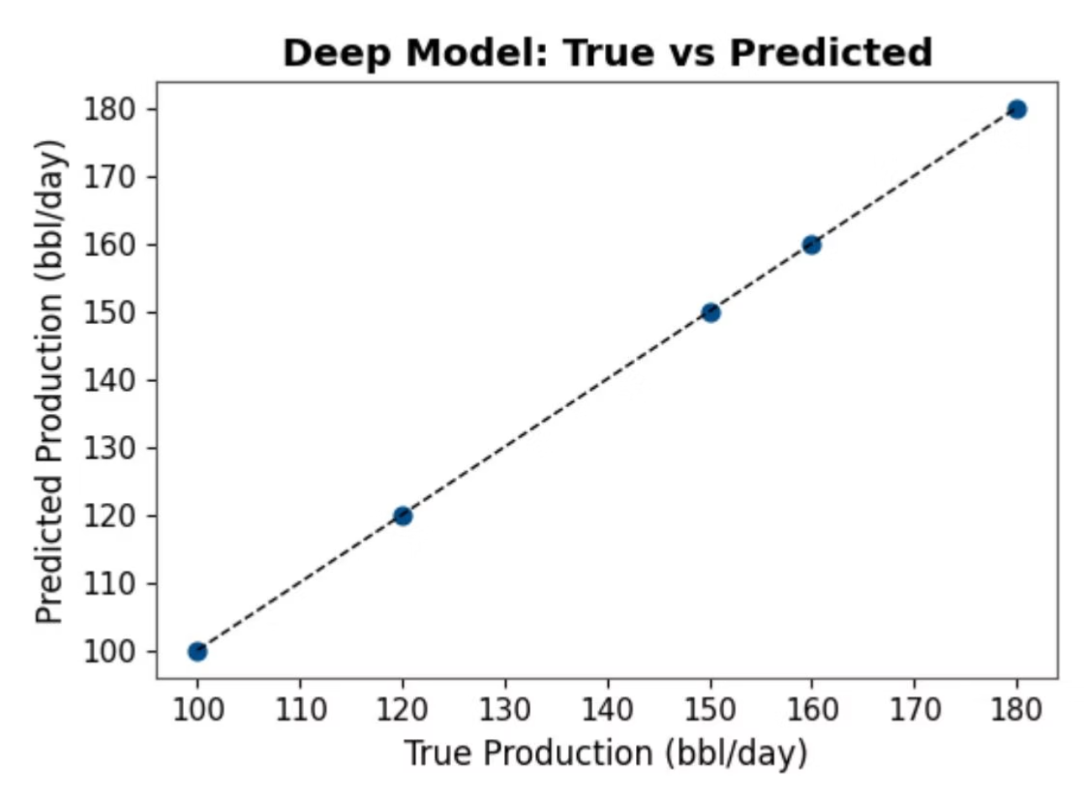
Shallow vs Deep Learning
We compare three approaches on a well dataset:
Linear Regression (R² = 1.0)
Random Forest - shallow ensemble (R² = 0.954)
PyTorch MLP - deep learning (R² = 1.0)
On tiny datasets, all models can fit well. However, deep models shine as data complexity grows, learning hierarchical features automatically.
Points closer to the dashed line indicate better fit

Slide 4
How Deep Learning Works
Model Architecture
Data Preparation
Stack linear layers + nonlinear activations (e.g., ReLU)
Standardize inputs for stable optimization
model = nn.Sequential( nn.Linear(4,32), nn.ReLU(), nn.Linear(32,16), nn.ReLU(), nn.Linear(16,1))
scaler = StandardScaler().fit(X)Xs = scaler.transform(X).astype('float32')
Regularization
Training Process
Control overfitting with regularization (dropout, weight decay) and validation splits
Define a loss function (e.g., MSE) and optimize (e.g., Adam)
opt = optim.Adam(model.parameters(), lr=1e-2)loss_fn = nn.MSELoss()

Slide 5
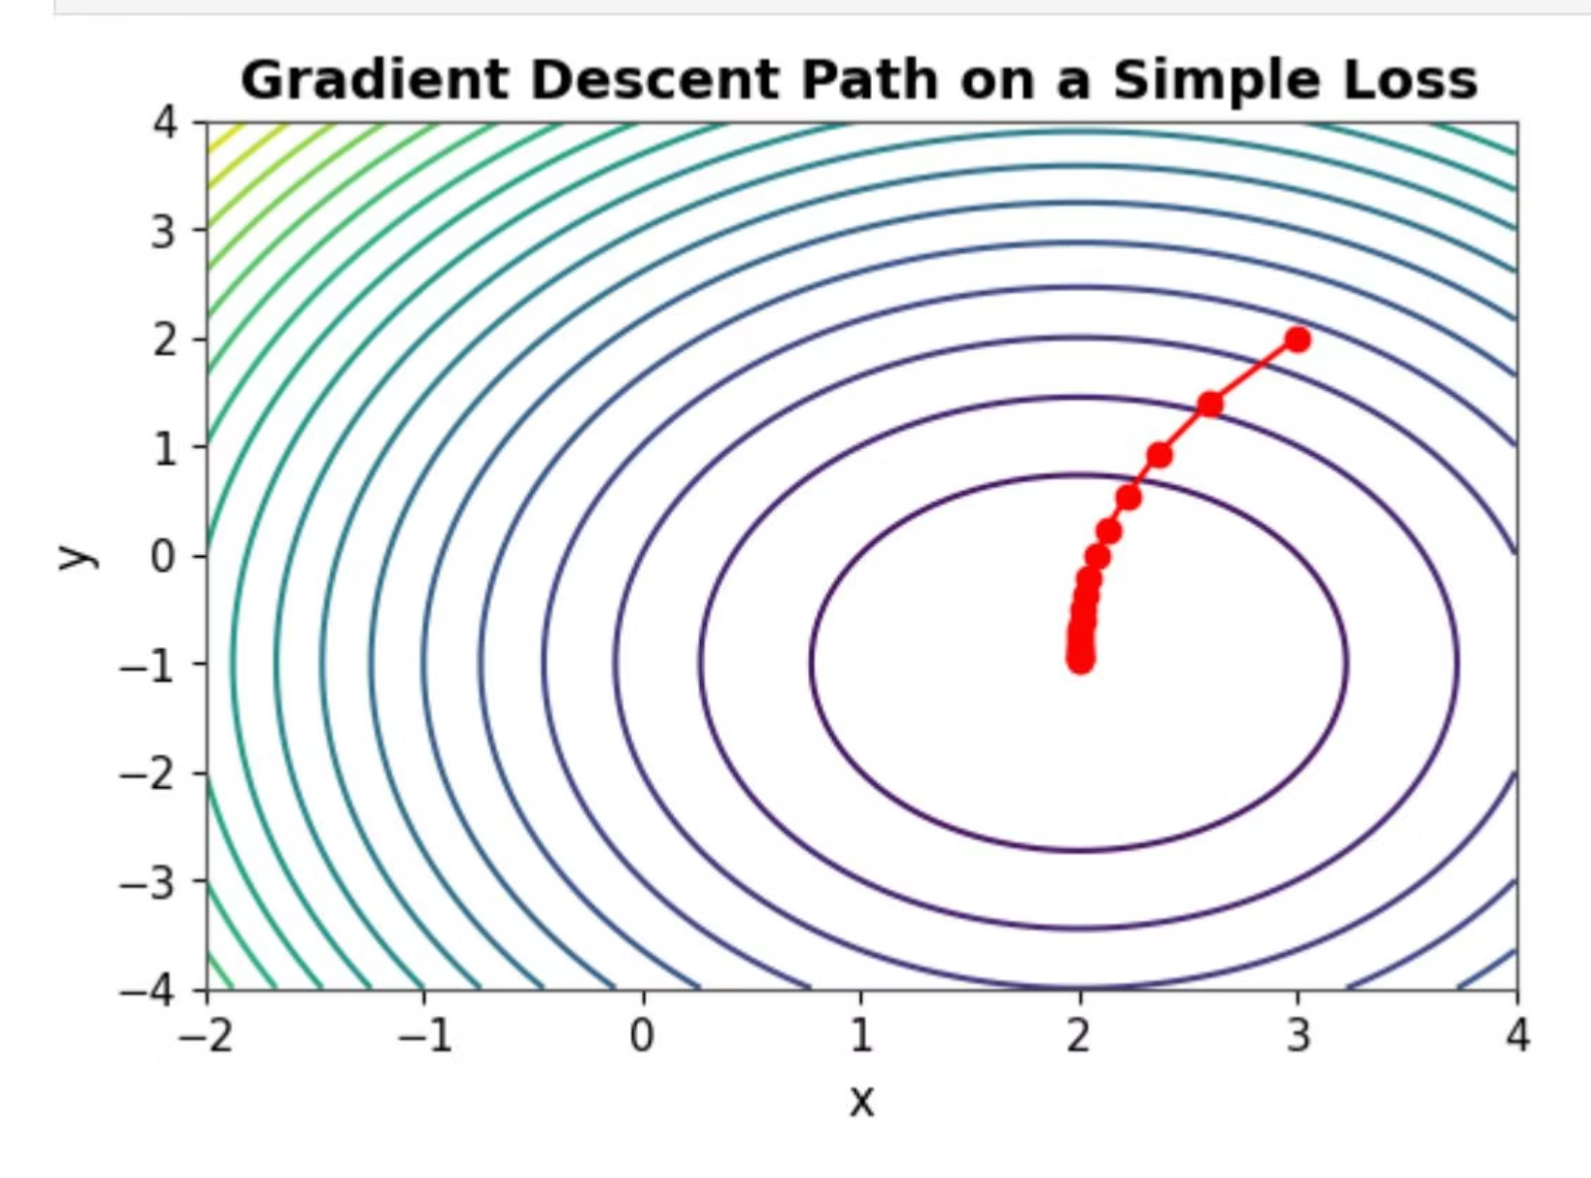
Learning vs Pure Optimization
Key Distinction
Learning targets generalization to unseen data; optimization simply targets minimizing training loss.
Challenges in neural network optimization include:
Finding global minima in non-convex landscapes
Avoiding overfitting to training data
Balancing exploration vs exploitation
Selecting appropriate learning rates
Gradient descent steps move along steepest descent; learning requires validation and regularization to avoid overfitting.

Slide 6
Deep Learning Challenges in Oil & Gas
Limited Labeled Data
High Dimensionality
Petroleum datasets often have few labeled examples, making training difficult
Seismic, well logs, and production data are complex and multi-dimensional
Noise & Uncertainty
Domain Knowledge Gap
Measurements contain significant noise and geological uncertainty
Bridging petroleum engineering expertise with AI techniques requires interdisciplinary skills
These challenges require specialized approaches like data augmentation, transfer learning, and incorporation of physical constraints.

Slide 7
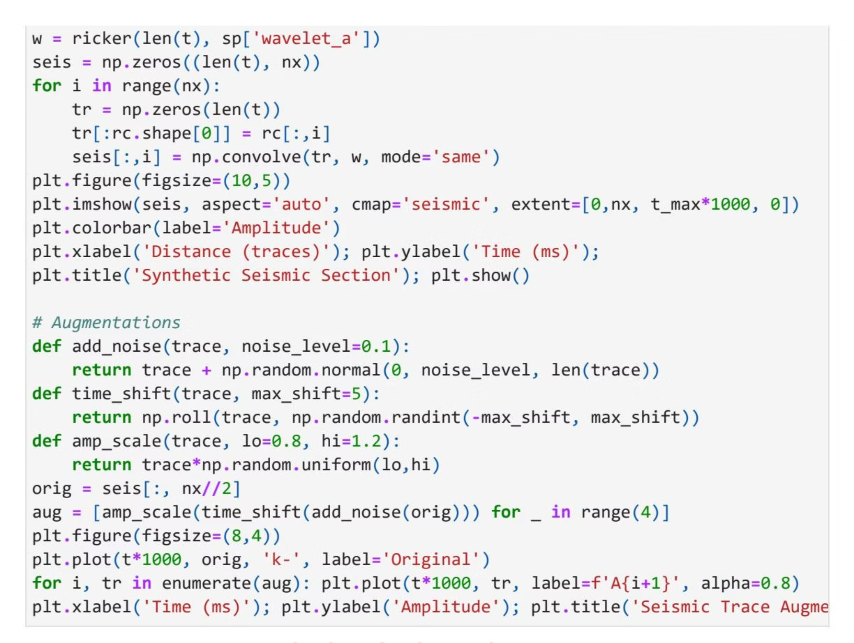
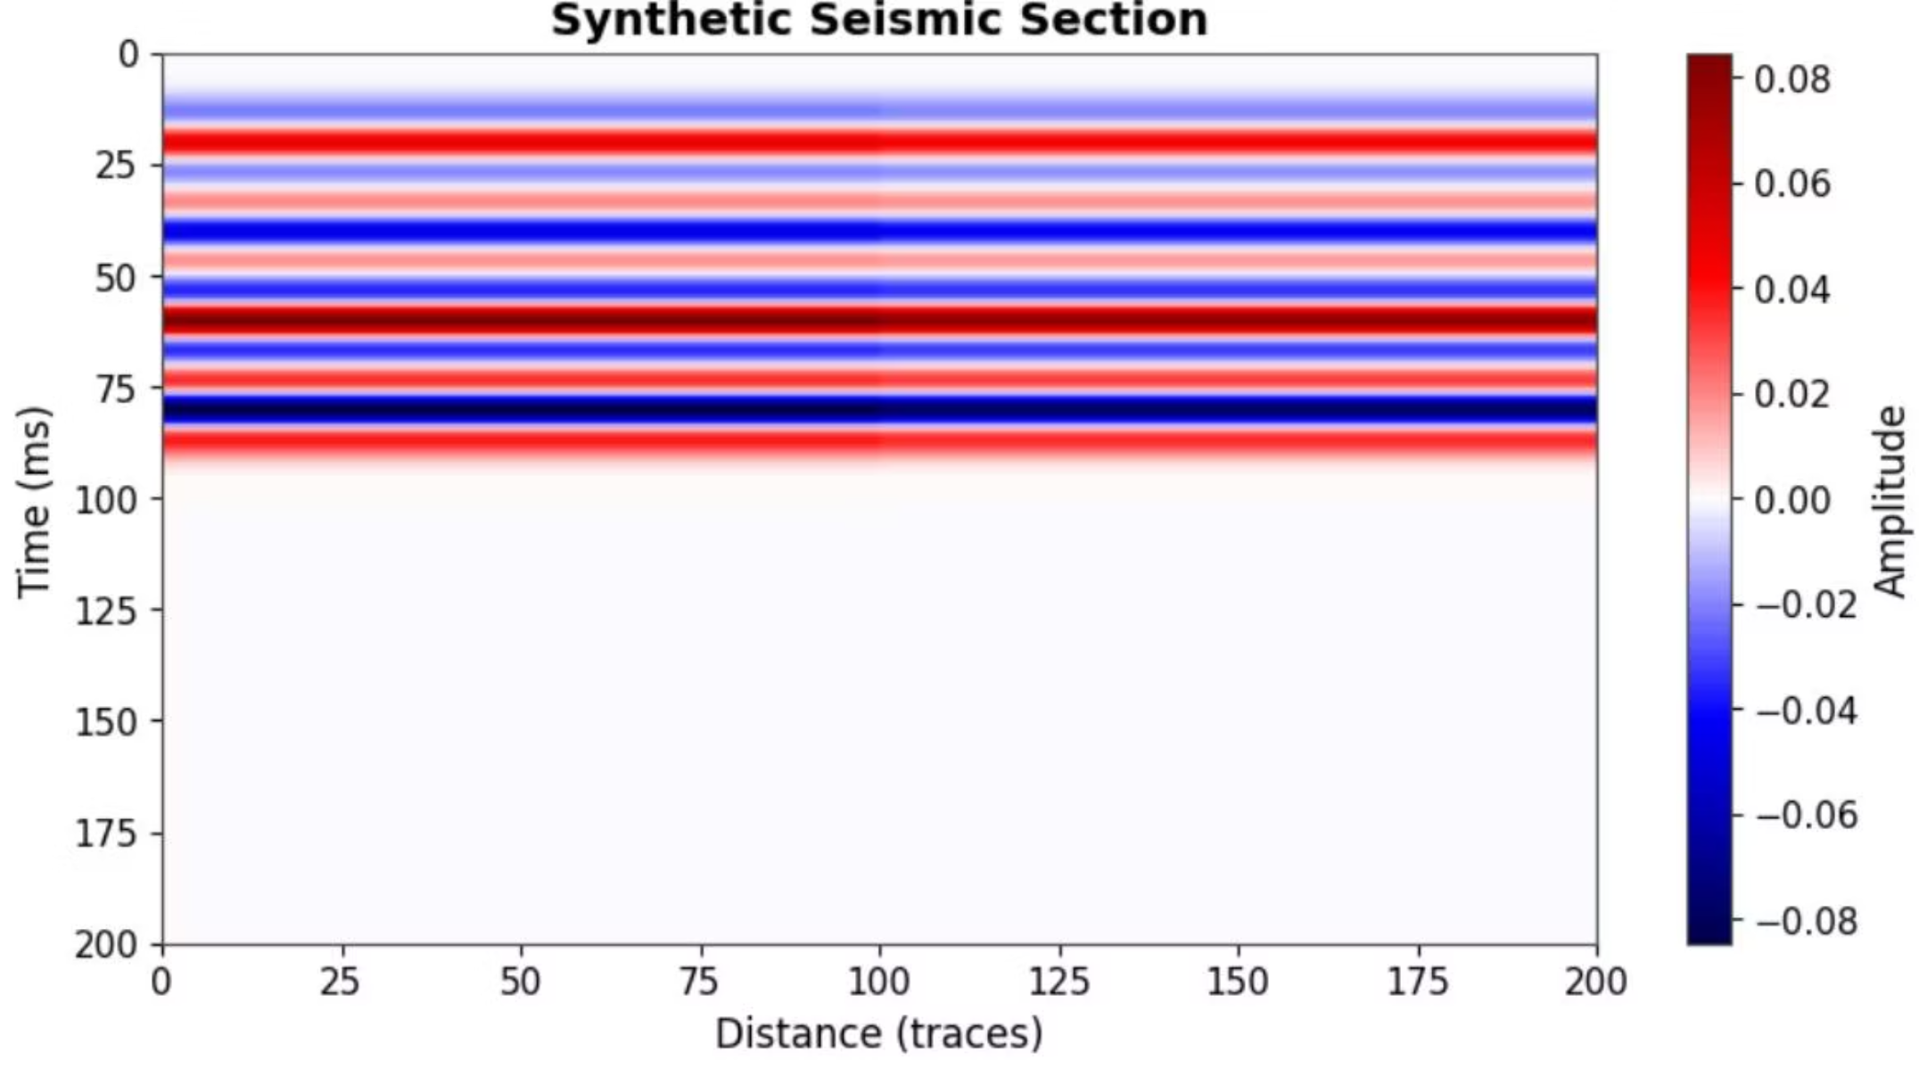
Seismic Data Challenges & Augmentation
We synthesize a layered velocity model to demonstrate:
Reflection coefficient calculation
Ricker wavelet convolution
Simple augmentations:
Noise addition
Time shifts
Amplitude scaling
These techniques expand limited labeled data and improve model robustness.

Slide 8



Summary & Next Steps
Shallow vs Deep Learning
Learning Principles
Data Challenges
Illustrated differences on well dataset
Optimization vs generalization clarified
Seismic generation + augmentations
Practical Next Steps:
Swap JSONs with your real data and re-run
Add validation splits and dropout for more realistic training
Create larger synthetic datasets for better training curves
Explore more complex architectures for your specific problems

